Slide 1
ENSEMBLE MODELS
What are Ensembles ?
Why use Ensemble models ?
When and where to use Ensemble models ?

Slide 2
What are ensembles?
Using Multiple ML models together at the same time to build more powerful model.
Accuracy of Ensemble model is supposed to be better than individual model.
Better Accuracy (Low Error)
Higher Consistency (Avoiding Overfitting)
Reduces Variance errors

Slide 3
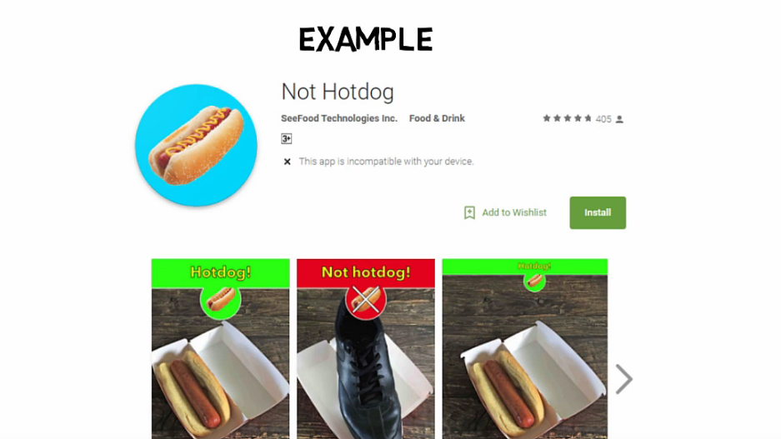

Slide 4
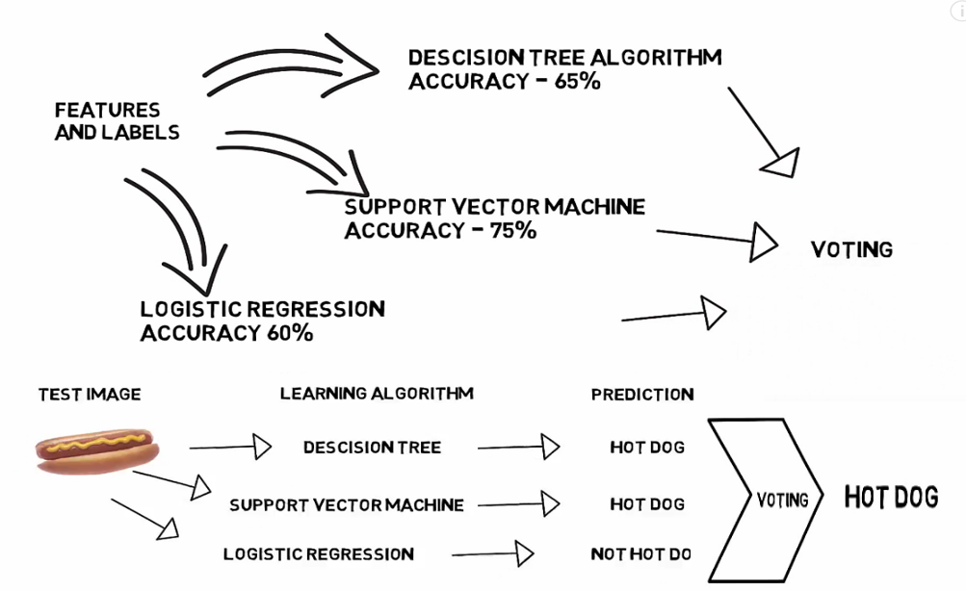

Slide 5
When and where to use ensemble models?
Single Model Overfits
Results worth the extra training
Can be used for Classification as well as Regression

Slide 6
Popular ensemble Models
BAGGING ( Bootstrapped Aggregation)
BOOSTING
STACKING
CASCADING

Slide 7
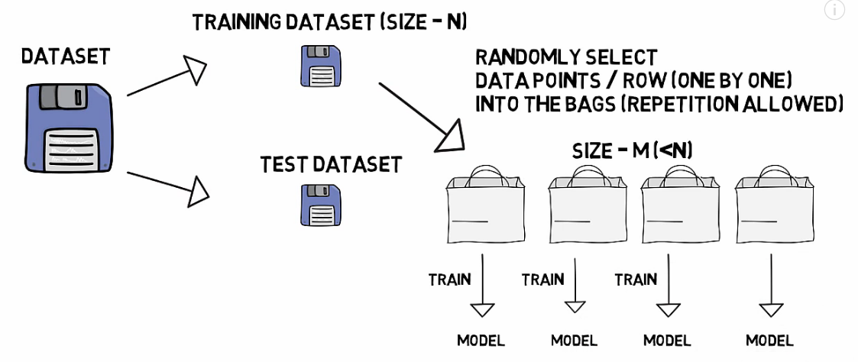
Bagging (Bootstrap Aggregating)
Multiple models of the same learning algorithm trained with the subsets of dataset randomly picked from the training dataset.
Helps in reducing the variance in a model without impacting the bias.
Ex: Random Forest

Slide 8
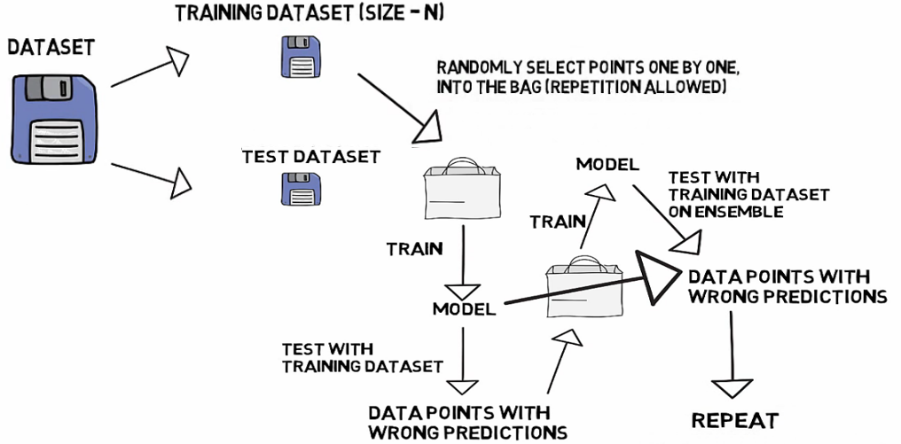
BOOSTING
Little Variation on Bagging
Selecting points which give wrong predictions.

Slide 9
THANK YOU

